Slide 1
The CVR Periodic Table
ore alence adius
C
V
R
A. The core, valence, radius (CVR) model separates the ______ level electrons from the ____ level electrons.
valence
inner

Slide 2
The CVR Periodic Table
ore alence adius
C
V
R
1. To determine the effective _______charge (Z_{eff}) on an electron, _______ the number of inner shell electrons from the number of protons in the nucleus.
nuclear
subtract

Slide 3
The CVR Periodic Table
ore alence adius
C
V
R
a. Effective nuclear charge is also referred to as effective ____ charge.
core

Slide 4
The CVR Periodic Table
ore alence adius
C
V
R
2. The _______ level is the outermost level of electrons and is most important in determining an atom’s chemistry.
valence

Slide 5
The CVR Periodic Table
ore alence adius
C
V
R
3. The atomic ______ of an atom is the distance from the center of the nucleus to the outer edge of the electron cloud.
radius

Slide 6
The CVR Periodic Table
ore alence adius
C
V
R
a. The atomic radius is determined in large part by the pull of the positive _______ in the nucleus and the number of main ______ levels.
charges
energy

Slide 7
The CVR Periodic Table
ore alence adius
C
V
R
b. The energy of attraction (or repulsion when the charges are the same) is governed by _________ law, where Q₁ and Q₂ are the charges, and r is the distance between those charges
Coulomb’s

Slide 8
The CVR Periodic Table
ore alence adius
C
V
R
1. As the effective core charge increases across a period , the force on the valence electrons ________.
Increases

Slide 9
The CVR Periodic Table
ore alence adius
C
V
R
2. As the distance over which the effective core charge must pull increases (as number of energy levels increase), the force on the valence electrons ________.
decreases

Slide 10
The CVR Periodic Table
ore alence adius
C
V
R
B. The resulting model simplifies the depiction of the atom and focuses on the _______ electrons which directly affect the chemistry of the atom.
valence
chemistry

Slide 11
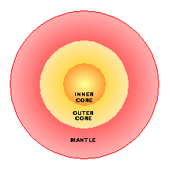
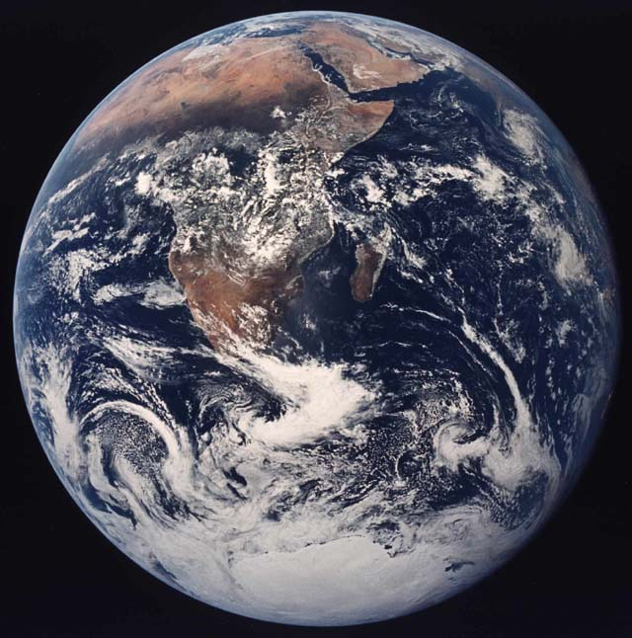
ore alence adius
C
V
R
+2
+
+
+
+
+
+
+
+
+
+
+
+
Magnesium
Crust

Slide 12
+
+
+2
+
+
+
+
+
+
+
+
+
+
Magnesium

