Slide 1
CONTENT OBJECTIVE
WHAT THE HECK DO I NEED TO BE ABLE TO DO?
express the arrangement of electrons in atoms through electron configurations.
I can

Slide 2
Electron Configurations
A. A _______ ____ configuration is an electron configuration that utilizes a noble gas which has its _________ level fully occupied.
NOBLE
GAS
VALENCE

Slide 3
Electron Configurations
[He]=1s²
[Ne]=1s²2s²2p⁶
[Ar]= 1s²2s²2p⁶ 3s²3p⁶
[Kr]= 1s²2s²2p⁶ 3s²3p⁶4s²3d¹⁰4p⁶
[Xe]= 1s²2s²2p⁶ 3s²3p⁶4s²3d¹⁰4p⁶5s²4d¹⁰5p⁶
[Rn]= 1s²2s²2p⁶ 3s²3p⁶4s²3d¹⁰4p⁶5s²4d¹⁰5p⁶6s²4f¹⁴5d¹⁰6p⁶

Slide 4
Electron Configurations
1. Noble gas configurations are often used to help __________ the electron configurations of those elements that contain large numbers of electrons.
shorten

Slide 5
Electron Configurations
A. The periodic table holds the answer for the order in which electrons ____ orbitals.
1. Always start at ___________ and then move through the periods (rows) until you arrive at the desired element.
fill
hydrogen

Slide 6
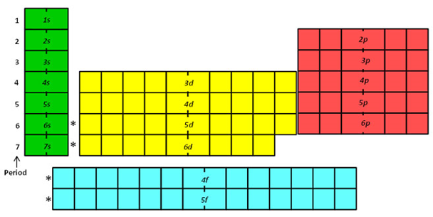

Slide 7
Electron Configurations
The Order in Which Electrons FILL Energy Levels
1s²2s²2p⁶3s²3p⁶4s²3d¹⁰4p⁶5s²4d¹⁰5p⁶6s²4f¹⁴5d¹⁰6p⁶7s²5f¹⁴6d¹⁰

Slide 9
Electron Configurations
B. When _________ electrons, once you get to scandium, the energy of the 3d orbitals becomes slightly less than that of the 4s, and that remains true across the rest of the transition series metals. Focus on the idea of ENERGY!
adding

Slide 10
Electron Configurations
Total Number
of Electrons
Main Energy
Level
Type of
Sublevel

